Slide 1

Docker Networking 101
By Chetan Shah

Slide 2
Docker Networking

Slide 3
Docker Networking
Docker creates many containers that need to talk to the outside world and also each other.
Out of the box, Docker provides 5 mechanisms to Network. These are:
Bridge (Default) - Single Host
Host - Single Host
Overlay - Multi Host
Macvlan - MAC address based for Legacy Applications
None

Slide 4
Docker Networking Commands
List networks - docker network ls
Inspect a bridge - docker network inspect bridge
Create a network - docker network create
Create a MACVLan Network - docker network create -d macvlan --subnet=172.16.86.0/24 --gateway=172.16.86.1 -o parent=eth0 pub_net
Create a Overlay Network - docker network create -d overlay --attachable my-attachable-overlay
Remove a network - docker network rm my-net

Slide 5
Docker Networking Commands
Create 2 containers:
docker run -dit --name busybox1 busybox
docker run -dit --name busyboxZ busybox
Get IP address of a Container: docker inspect -f '{{range.NetworkSettings.Networks}}{{.IPAddress}}{{end}}' busybox1
Ping one container from the other using IP address: docker exec -it busybox1 ping 172.17.0.5
Ping one container from the other using Container Name: docker exec -it busybox1 ping busybox5 (doesn’t work as automatic discovery not supported)

Slide 6
Docker Networking Commands
docker network create my_bridge --driver bridge
docker network connect my_bridge busybox1
docker network connect my_bridge busybox2
docker exec -it busybox2 ping busybox1 (now automatic discovery is supported)

Slide 7
Docker Networking - Bridge
The Docker daemon creates virtual ethernet bridge docker0, that automatically forwards packets between any other attached network interfaces.
By default, all containers on a host will be connected to the internal network.
This mode puts the container on a separated network namespace, and shares the external IP address of the host amongst the many containers through the use of Network Address Translation.
The drawback of this is that NAT introduces some network latency due to the translation involved. Another drawback being the port mapping that needs to be taken care of.

Slide 8
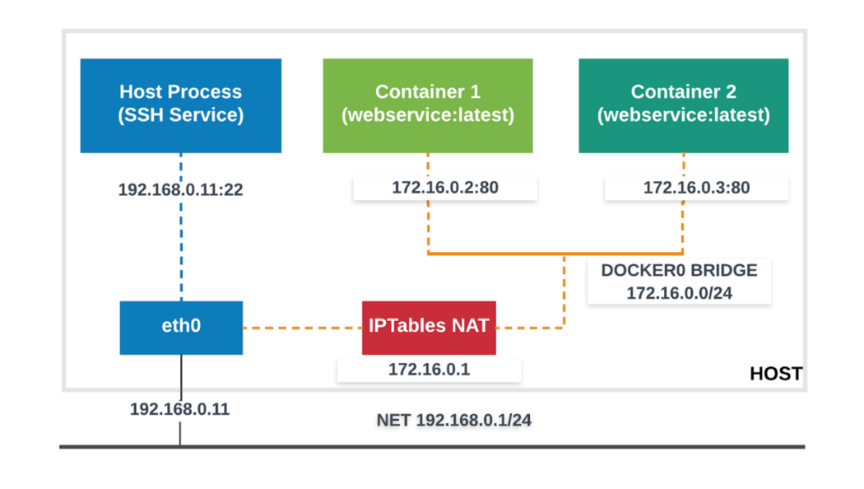
Docker Networking - Bridge Diagram

Slide 9
Docker Networking - Host
This mode allow the container shares the networking namespace of the host.
The container is directly exposed to the public network.
It will use the host’s IP address and host’s TCP port space to expose the services running inside the container.
docker run -d — net=host — name container webservice:latest
This mode is simpler to understand and implement, but has drawbacks.

Slide 10
Docker Networking - Bridge Diagram

Slide 11
Docker Networking - Host Advantages & Drawbacks
The Host mode is easy to understand, use and troubleshoot.
The drawbacks though are:
No dynamic port assignment mechanism, will lead to conflict leading to failure in launching of the service.
Vulnerability due to sharing of network namespace between the host and the containers.

Slide 12
Docker Networking - Overlay
Overlay Networking provides simple and secure multi host networking.
The overlay network makes use of VXLAN over underlying network.
Containers that are part of Overlay Network can communicate with containers regardless of the host.
Containers part of Overlay network see each other if they are on same L2 network.

Slide 13
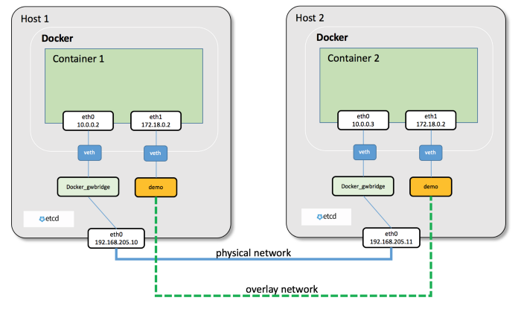
Docker Networking - Overlay Diagram

Slide 14
Docker Networking - Overlay Advantages & Drawbacks
Containers across multiple hosts on the container platform can communicate with each other
The overlay network is a distributed network created among multiple Docker daemons in different hosts. All containers connected to this network can communicate.
Depending on the use case, Overlay may not be an option - eg. connecting legacy applications

Slide 15
Docker Networking - MACVLan
Macvlan networks allow you to assign a MAC address to a container, making it appear as a physical device on your network.
The Docker daemon routes traffic to containers by their MAC addresses.
Using the macvlan driver is sometimes the best choice when dealing with legacy applications that expect to be directly connected to the physical network, rather than routed through the Docker hosts network stack.

Slide 16
Docker Networking - None
Often, it is needed to isolate a container from ingoing/outgoing traffic,
The none network that lacks a network interface
Hence the container will not have any possibility of getting connected with the outside world, or even with other containers.
The only interface the container will have is the local loopback interface (127.0.0.1).
‍

